Slide 1
Branch Strategies

Slide 2
What? Why?
How do we use SCM to effectively manage deployments?

Slide 3
2 Approaches
Branches VS NO Branches

Slide 4
With branches
isolation
code review
decomposition
Challenges:
hard to maintain
tend to be messy
slow down development
delayed feedback and integration

Slide 5
No branches *
(*) you still have main branch
fast development ( direct commits )
fast feedback and integration
easy deployment strategy
simplicity
Challenges:
easy to break things
more responsibility ( it’s pros too! )
needs rigorous automatic testing

Slide 6
What do we choose?
be “safe” and slow
be “broken” and fast

Slide 7
Branch strategies pitfalls

Slide 8
Long living branches
They are: * hard to review ( no context as time goes by ) * tend to have a lot of changes ( a dozens of files ) * inconsistent with a main branch * not integrated ( sandboxes and laptops ) - it works for me!

Slide 9
Branches and environments
Branches are NOT environments
Branches could be used for dedicated environments deployments
dev => dev, test => test, prod => prod - just makes things messy
excessive branches , KIS

Slide 10
Main branch is broken
I’ll fix it later
We don’t have a reference build and app
We not sure about application state
Tests fails - let’s skip them

Slide 11
GitFlow Strategy
By Vincent Driessen, 2010
Dedicated branches for dedicated workflows (feature branches, development, release, hotfixes)
“With branches” strategy
Works well if we have big enough team to split by different flows - development, release maintenances, and bug fixing
Has a lot of (long living) branches and a lot of merges - require a lot of discipline and dedicated person to look after
Relatively slow

Slide 12
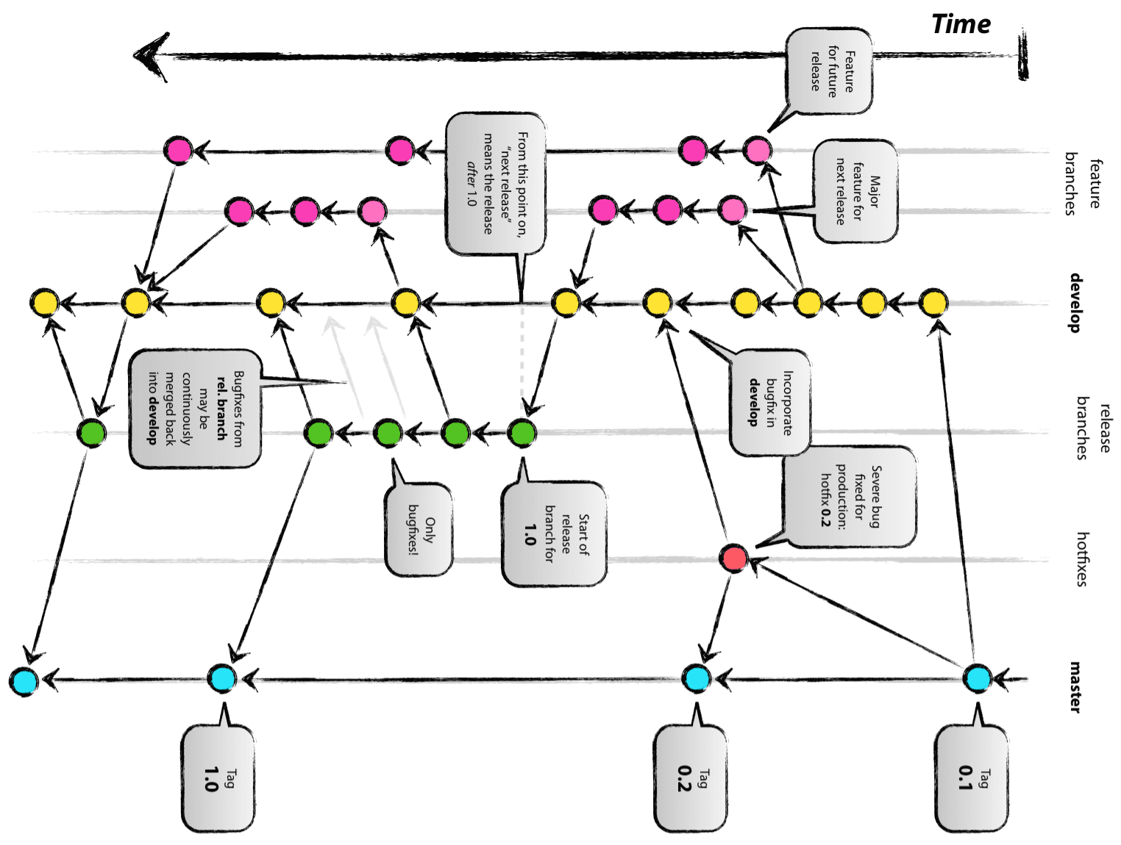
GitFlow Model

Slide 13
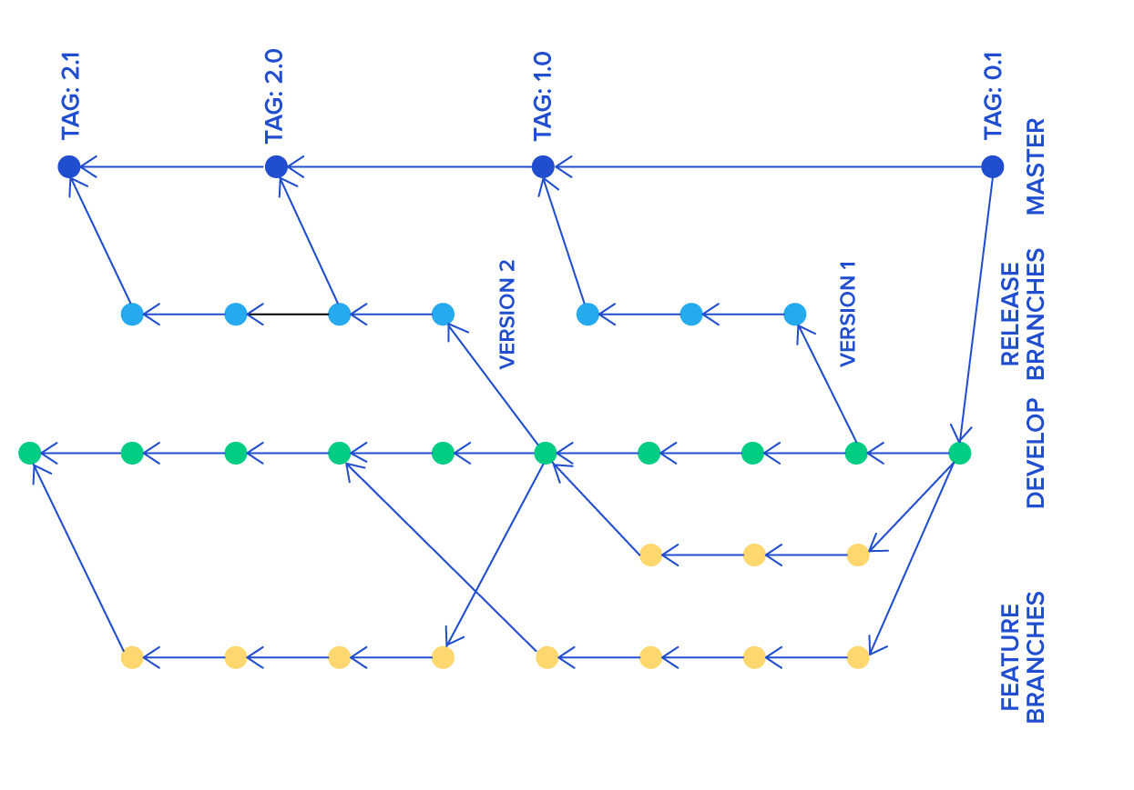
GitFlowish Models

Slide 14
Trunk Based Development
one main and stable branch
no other long living branches - no merge hell
direct commits to main or frequent PR from short living branches
easy to break - easy to fix - responsibility - roll back system - a lot of tests
GitHubFlow development - similar
release branches - optional or release always from trunk
code reviews as whole source code or code review in PR or pair programming
reproduce bugs on main and cherry pick commits (back to release branch)
strict code style, mature team

Slide 15
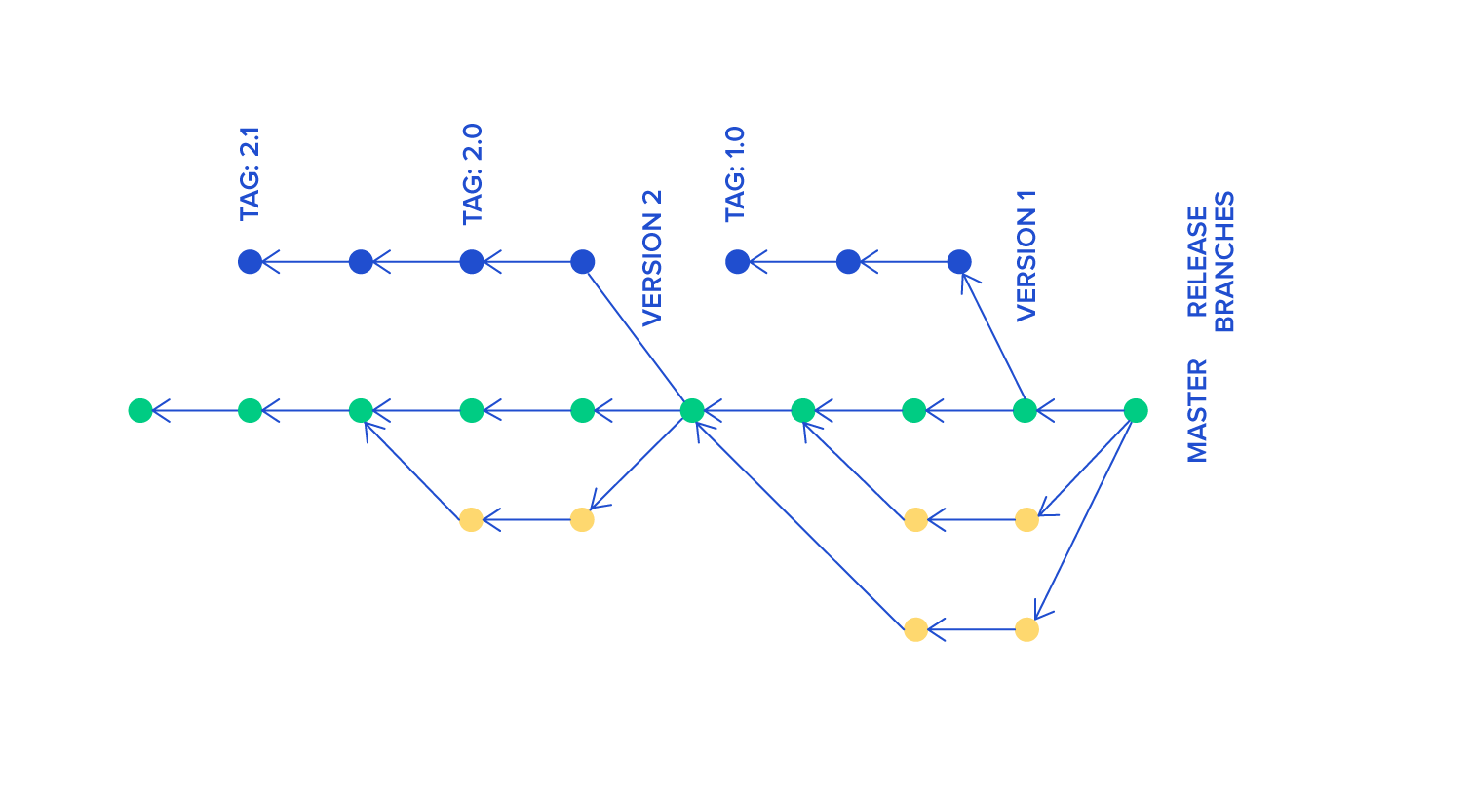
Trunk Based Development Model

Slide 16
Mitigating TDD challenges
fast delivery
branches by abstraction VS branches
everything in a main branch!

Slide 17
Rollbacks
Available in both GF and TBD using tags artifacts.
Hase nothing to with branches
Branches to go back to a certain point of source code

Slide 18
Q/A

